Slide 1
Explaining how romans used the baths

Slide 2
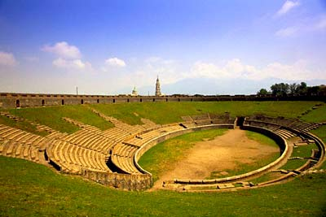
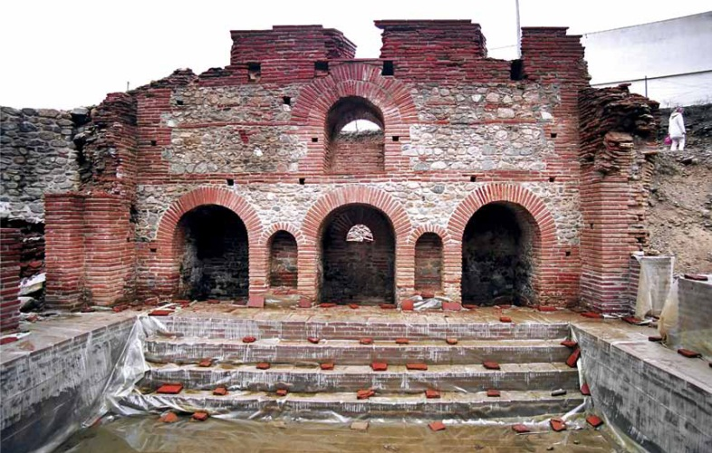
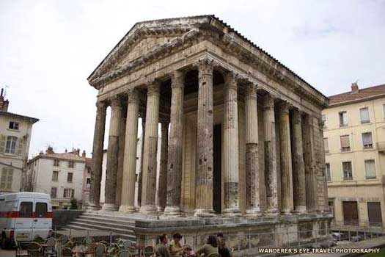
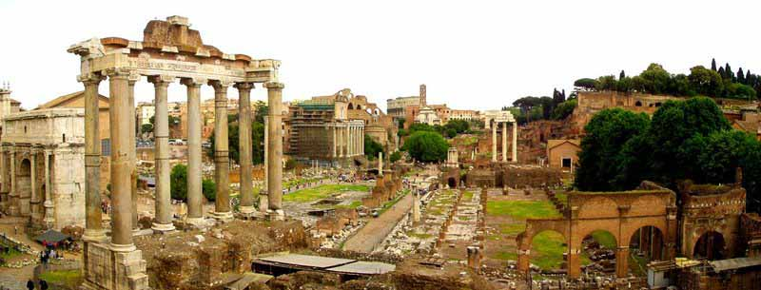
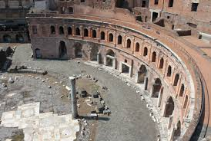
Here are some ruins of buildings found in a roman town. Can you recognise them. Match the sentences to the pictures.
b)
a)
d)
c)
Shops were usually in the centre of a town.
e
The forum was the town square where people met.
The temple was where people went to pray to a god.
The baths were where people went to get clean.
The amphitheatre was where people went to watch plays.

Slide 3
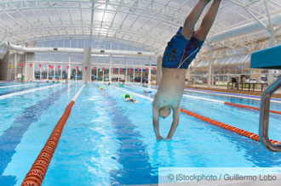
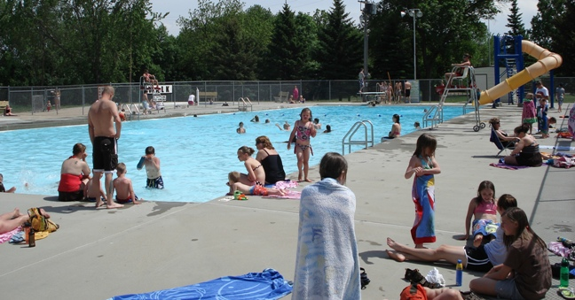
A Swimming Pool
What do you see when you go to a swimming pool
What can you do there?

Slide 4
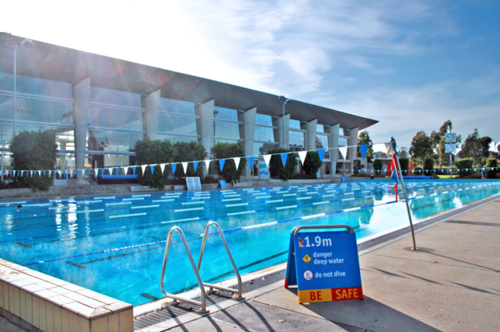
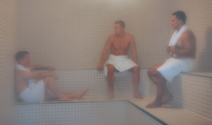
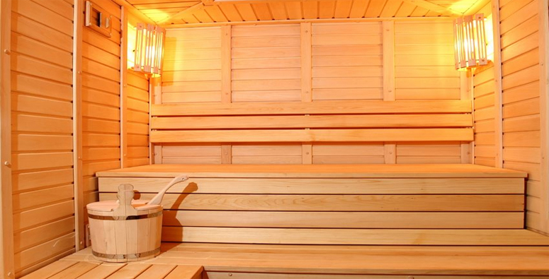
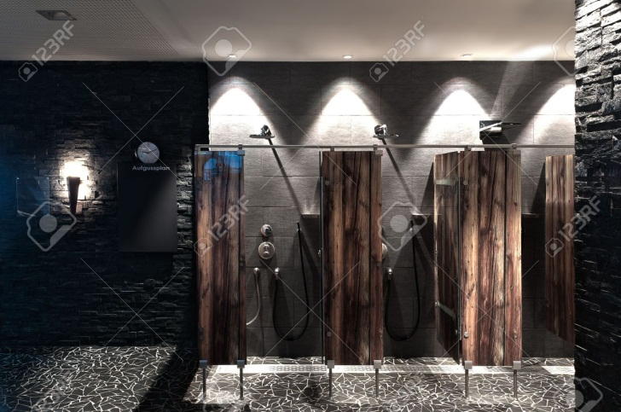
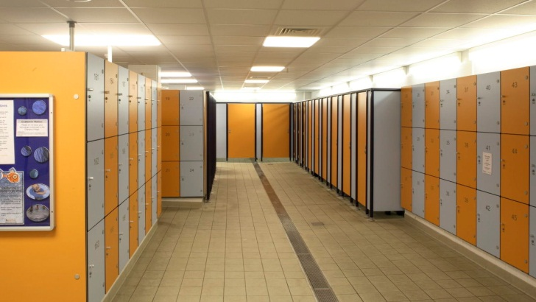
Here are some features of a swimming pool. What are they for?

Slide 5
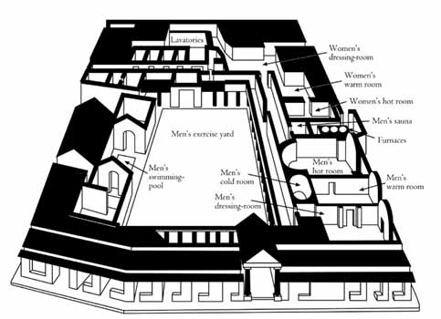
The Romans used to go to the baths
They could swim at the baths. They could do many other things there too.
Say whether the sentences are true or false
Men and women went in the same swimming pool.
There was an exercise yard for women.
The exercise yard was in the centre of the bath house
The men’s dressing room was next to the men’s hot room.
The swimming pool was on the same side as the baths as the dressing rooms.
The hot room was next to the warm room.
What do you think the exercise yard was for? What do you think the hot room was for?

Slide 6
Rooms in the Roman Baths
The four main rooms in the baths were:
The swimming pool
The hot room with a hot water pool
The warm room
The cold room
Three of them were called
the frigidarium
the tepidarium
the caldarium
Which room was which?

Slide 7
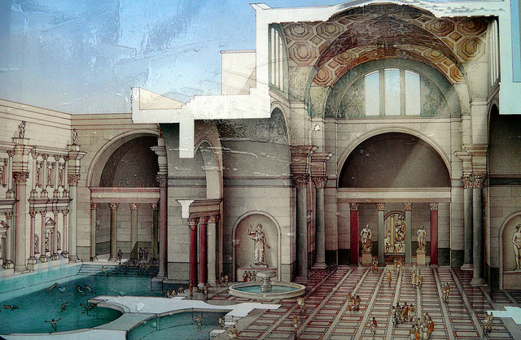
This is a picture of a room inside an ancient roman bath.
Which part of the baths do you think this is?

Slide 8
Here are some actions and activities that took place in the roman baths.
Match the verbs in the first column with the nouns in the second
get |  | in the pool
scrape |  | the skin sweat
rub in |  | changed
take |  | the skin
make |  | weights
relax |  | the muscles
lift |  | exercise
massage |  | the oil

Slide 9
Match the beginning and the end of each sentence.
Join them with the right conjunction
Romans went to the baths |  | they needed to get changed.
They went in the dressing rooms |  | to get clean and also to relax.
The went in the swimming pool |  | to get the dirt out.
They went in the hot room | so | that they could massage the customers.
They had to wear sandals in the hot room | because | to do weight lifting.
They scraped their sweaty skin with a stick | in order | the mosaic floor was heated.
There were slaves at the baths |  | they could rub their skin to get clean.
They took oil in the warm room |  | they needed to sweat.
Men went to the exercise yard |  | to relax.

Slide 10
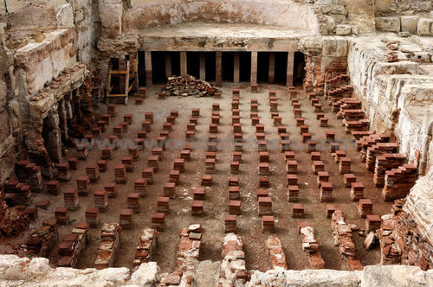
A fire burnt here
Empty spaces under the floor
Which room in the baths is shown in this picture?
I think it is the...................................because......................................
It could also be...................................since.........................................
swimming pool
hot room
cold room
warm room
the exercise yard

Slide 11
My visit to the baths
On .......day I went to the baths.
When I got there I............
The first place I went to was ............................. so that.......................................................
After ............. minutes I entered .......................in order to ...............................................
I stayed there for about.................and then I made my way to .................... because..........
Finally I.....................................................................................................................

